Slide 1
Pattern Recognition
Imran Siddiqi
imran.siddiqi@mcs.edu.pk
Notes:
Good Morning! My name is Chao.
Today I like to give a topic on “Content-Based Retrieval” which so called “CBR” in multimedia systems.

Slide 2
Contents
Introduction to Patterns and Pattern Recognition
Clustering vs. Classification
Template Matching
Features
Classification
Next Week

Slide 3
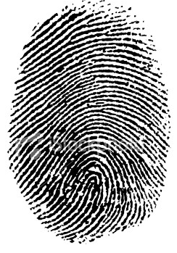
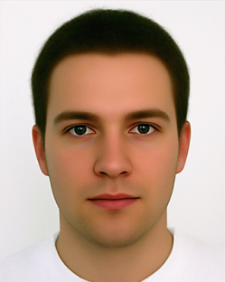

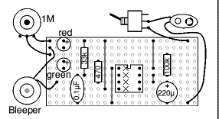

Pattern
A pattern is the opposite of a chaos, it is an entity that can be given a name
Notes:
Here is an outline for my presentation.
I am gonna talk about what is content-based retrieval CBR.
I am gonna introduce three major content-based retrieval in multimedia systems, which are CBIR, CBVR and CBAR.
And if time allows, I will briefly mention my proposals to effective CBR.

Slide 4
Recognition
Identification of a pattern as a member of a category
  Classification (Supervised: known categories)
  Clustering (Unsupervised: learning categories)
Notes:
Here is an outline for my presentation.
I am gonna talk about what is content-based retrieval CBR.
I am gonna introduce three major content-based retrieval in multimedia systems, which are CBIR, CBVR and CBAR.
And if time allows, I will briefly mention my proposals to effective CBR.

Slide 5
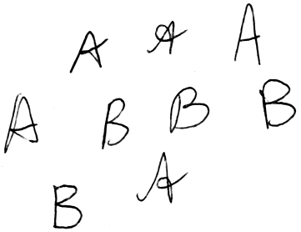



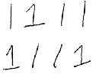









Classification vs. Clustering
Category “A”
Category “B”
Clustering
Classification
Notes:
Here is an outline for my presentation.
I am gonna talk about what is content-based retrieval CBR.
I am gonna introduce three major content-based retrieval in multimedia systems, which are CBIR, CBVR and CBAR.
And if time allows, I will briefly mention my proposals to effective CBR.

Slide 6
Pattern Recognition
Given an input pattern, make a decision about the “category” or “class” of the pattern
Notes:
Here is an outline for my presentation.
I am gonna talk about what is content-based retrieval CBR.
I am gonna introduce three major content-based retrieval in multimedia systems, which are CBIR, CBVR and CBAR.
And if time allows, I will briefly mention my proposals to effective CBR.

Slide 7
Pattern Class
A collection of similar (not necessarily identical) objects
Intra-class variability
Inter-class similarity

Slide 8
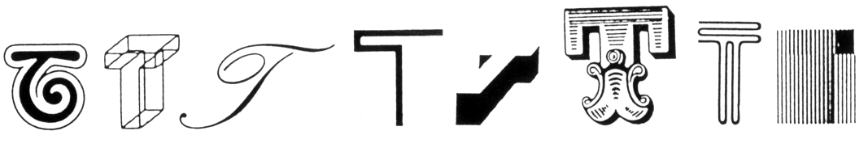
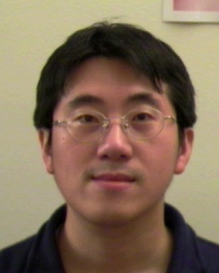
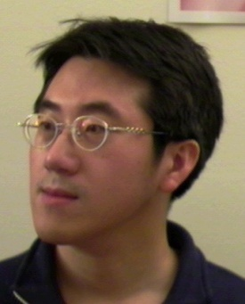
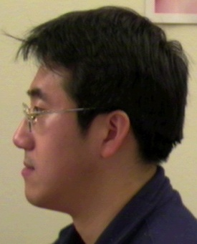
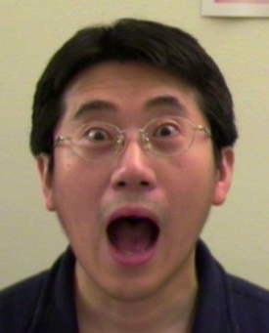
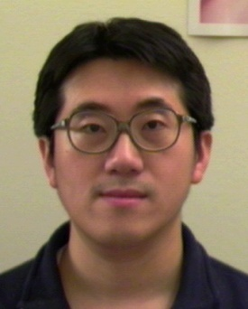
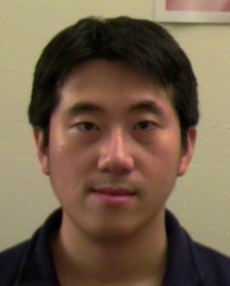
Pattern Class
Intra-class variability
The letter “T” in different typefaces
Same face under different expression, pose, illumination

Slide 9

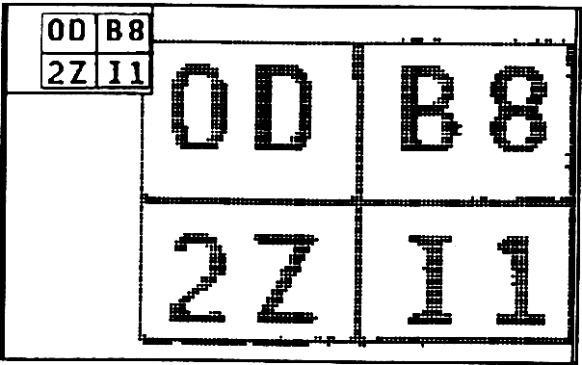
Pattern Class
Inter-class similarity
Characters that look similar
Identical twins

Slide 10
Approaches
Statistical PR:
  Pattern classes represented by statistical measures.
Structural (or Syntactic) PR:
  Pattern classes represented by means of formal structures as grammars, automata, strings, etc.

Slide 11

Template Matching
Image is converted into 12x12 bitmap.

Slide 12
Template Matching
Bitmap is represented by 12x12-matrix or by 144-vector with 0 and 1 coordinates.
0 | 0 | 0 | 0 | 0 | 0 | 1 | 1 | 0 | 0 | 0 | 0
0 | 0 | 0 | 0 | 0 | 1 | 1 | 1 | 0 | 0 | 0 | 0
0 | 0 | 0 | 0 | 0 | 1 | 0 | 1 | 1 | 0 | 0 | 0
0 | 0 | 0 | 0 | 1 | 1 | 0 | 1 | 1 | 0 | 0 | 0
0 | 0 | 0 | 0 | 1 | 0 | 0 | 0 | 1 | 0 | 0 | 0
0 | 0 | 0 | 1 | 1 | 0 | 0 | 0 | 1 | 1 | 0 | 0
0 | 0 | 0 | 1 | 1 | 0 | 0 | 0 | 1 | 1 | 0 | 0
0 | 0 | 1 | 1 | 1 | 1 | 1 | 1 | 1 | 1 | 1 | 0
0 | 0 | 1 | 1 | 0 | 0 | 0 | 0 | 0 | 1 | 1 | 0
0 | 1 | 1 | 0 | 0 | 0 | 0 | 0 | 0 | 1 | 1 | 0
0 | 1 | 1 | 0 | 0 | 0 | 0 | 0 | 0 | 0 | 1 | 1
1 | 1 | 0 | 0 | 0 | 0 | 0 | 0 | 0 | 0 | 1 | 1

Slide 13
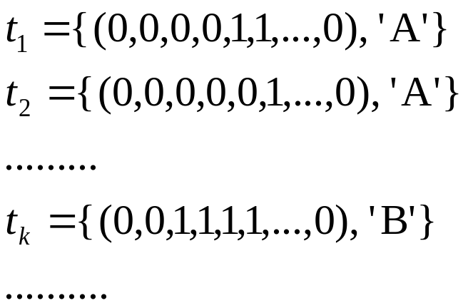

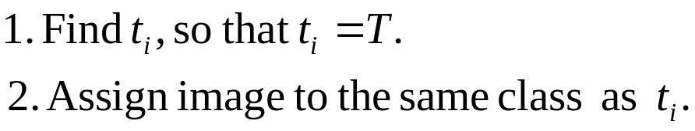
Template Matching
Training samples – templates with corresponding class:
Template of the image to be recognized:
?
Algorithm:

Slide 14
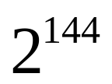
Template Matching
Number of templates to store:
If fewer templates are stored, some images might not be recognized.
Improvements?

Slide 15
References
  Graphical Models in Document Image Analysis - Venu Govindaraju, CEDAR
  Classification of Handwritings in the Perspective of Writer Recognition – PhD Thesis, I. Siddiqi, 2009
  Statistical Pattern Recognition: A Review – A.K Jain et al., PAMI (22) 2000
  Pattern Recognition and Analysis Course – A.K. Jain, MSU
  Introduction to Pattern Recognition -Vojtěch Franc, Czech Technical University in Prague
  Pattern Classification” by Duda et al., John Wiley & Sons.

